Slide 1



Name: Sakif Hossain Student ID: 10165984 Module: Data Analytics for International Business (BMG880)
View in Power BI
Last data refresh:
12/8/2022 11:45:20 PM UTC
Downloaded at:
12/8/2022 11:46:26 PM UTC

Slide 2
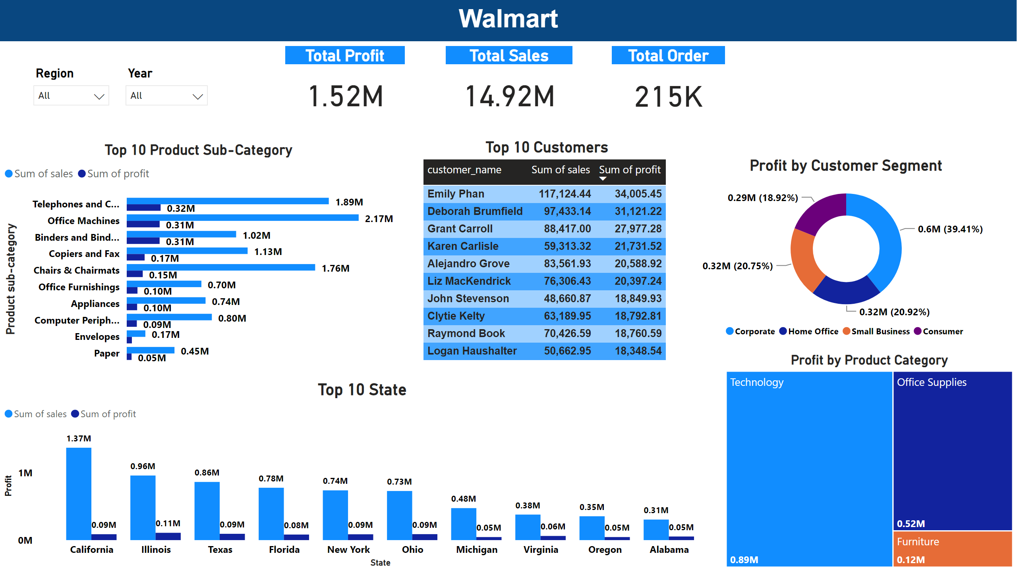
Report
Notes:
Total Profit
No alt text provided
Top 10 Product Sub-Category
No alt text provided
Top 10 State
No alt text provided
Region
No alt text provided
Profit by Customer Segment
No alt text provided
Profit by Product Category
No alt text provided
Top 10 Customers
No alt text provided
textbox
No alt text provided
Region
No alt text provided
Total Sales
No alt text provided
Total Order
No alt text provided

Slide 3
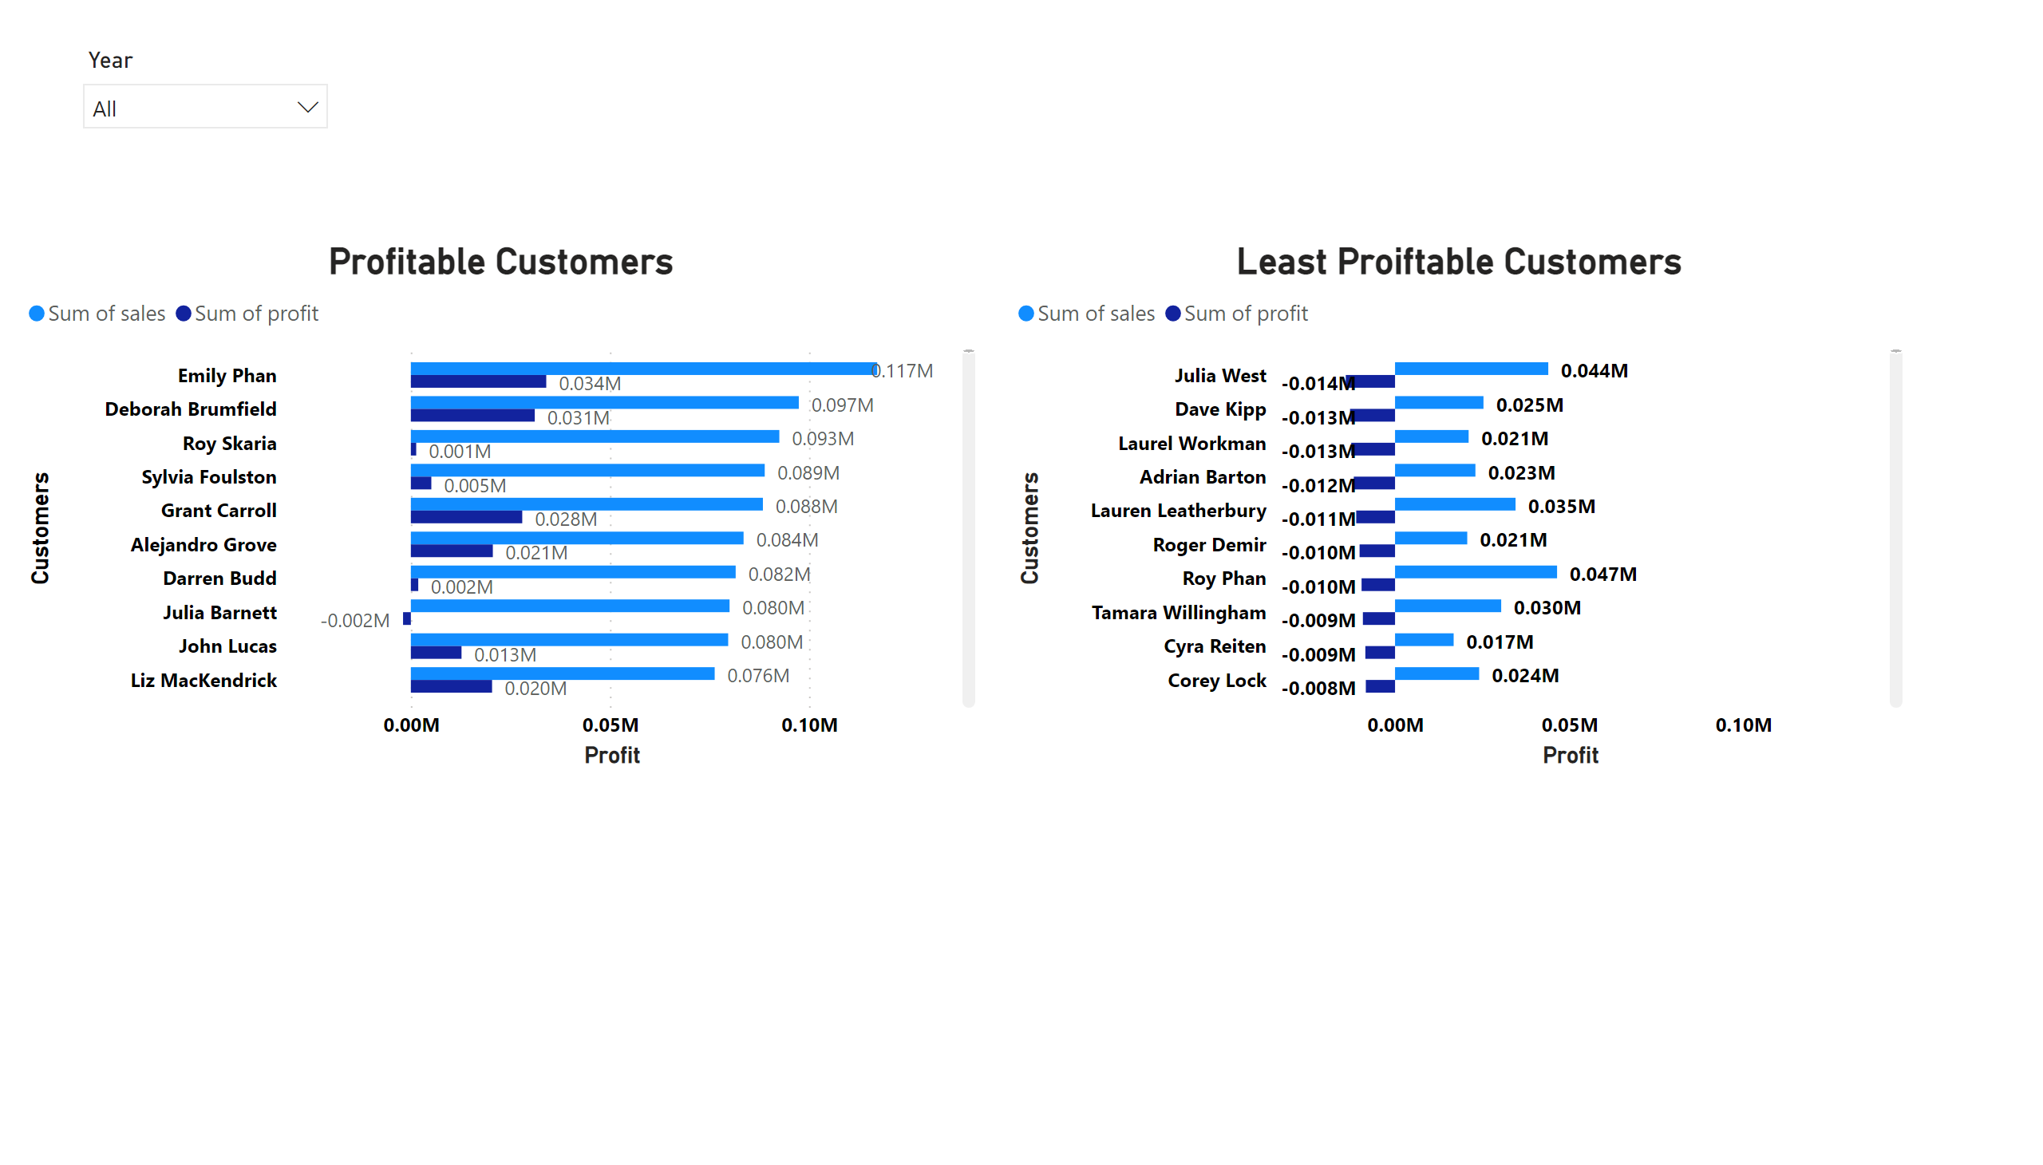
Customer
Notes:
Least Proiftable Customers
No alt text provided
Profitable Customers
No alt text provided
slicer
No alt text provided

Slide 4
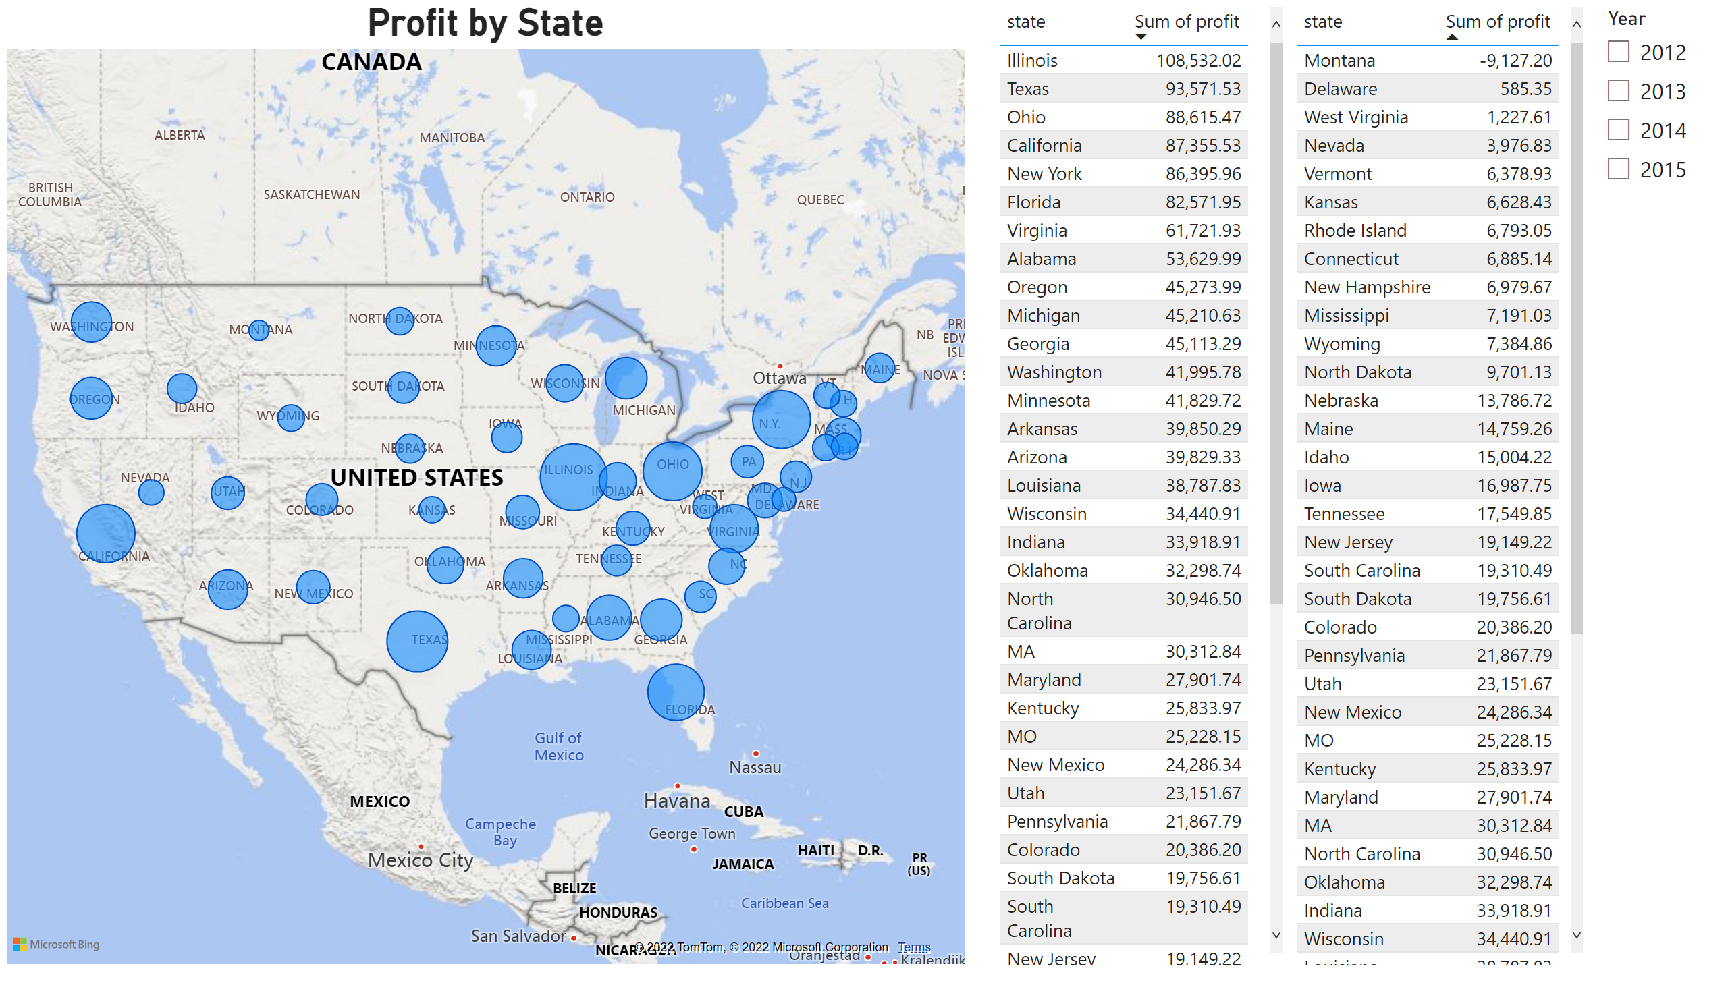
State by year
Notes:
tableEx
No alt text provided
tableEx
No alt text provided
slicer
No alt text provided
Profit by State
No alt text provided

Slide 5
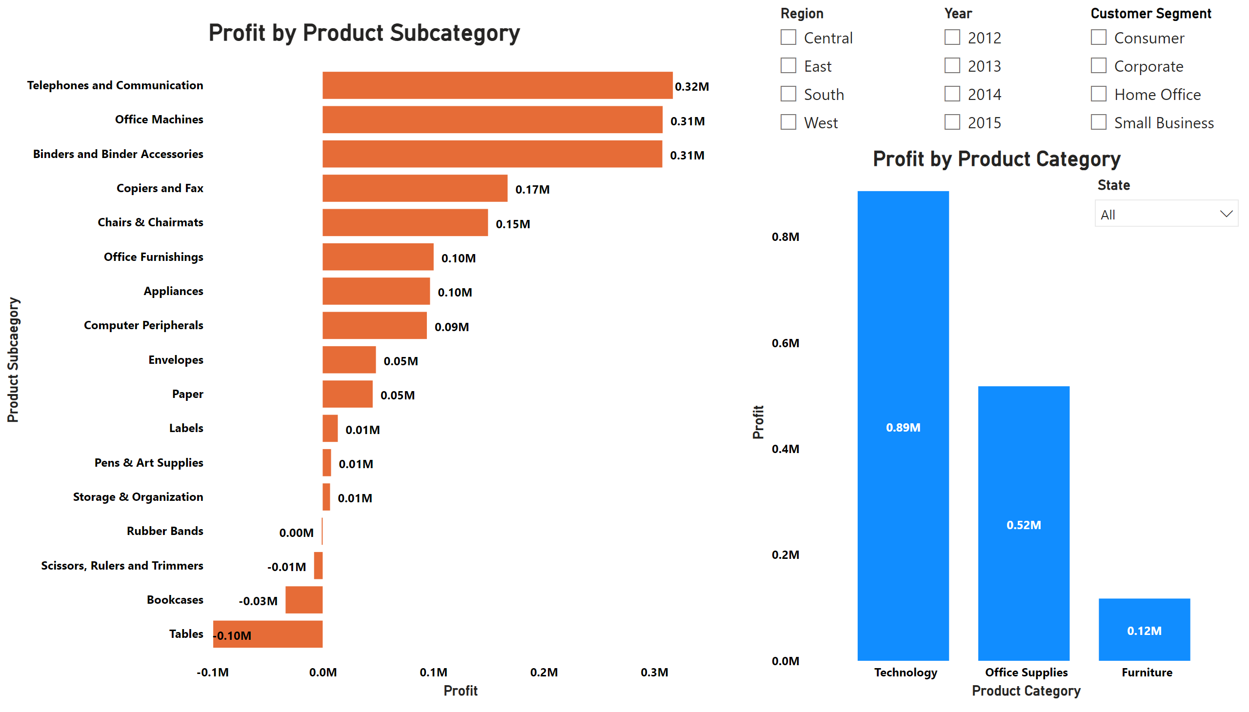
Product category and subcategories
Notes:
slicer
No alt text provided
Profit by Product Subcategory
No alt text provided
slicer
No alt text provided
slicer
No alt text provided
slicer
No alt text provided
Profit by Product Category
No alt text provided

Slide 6
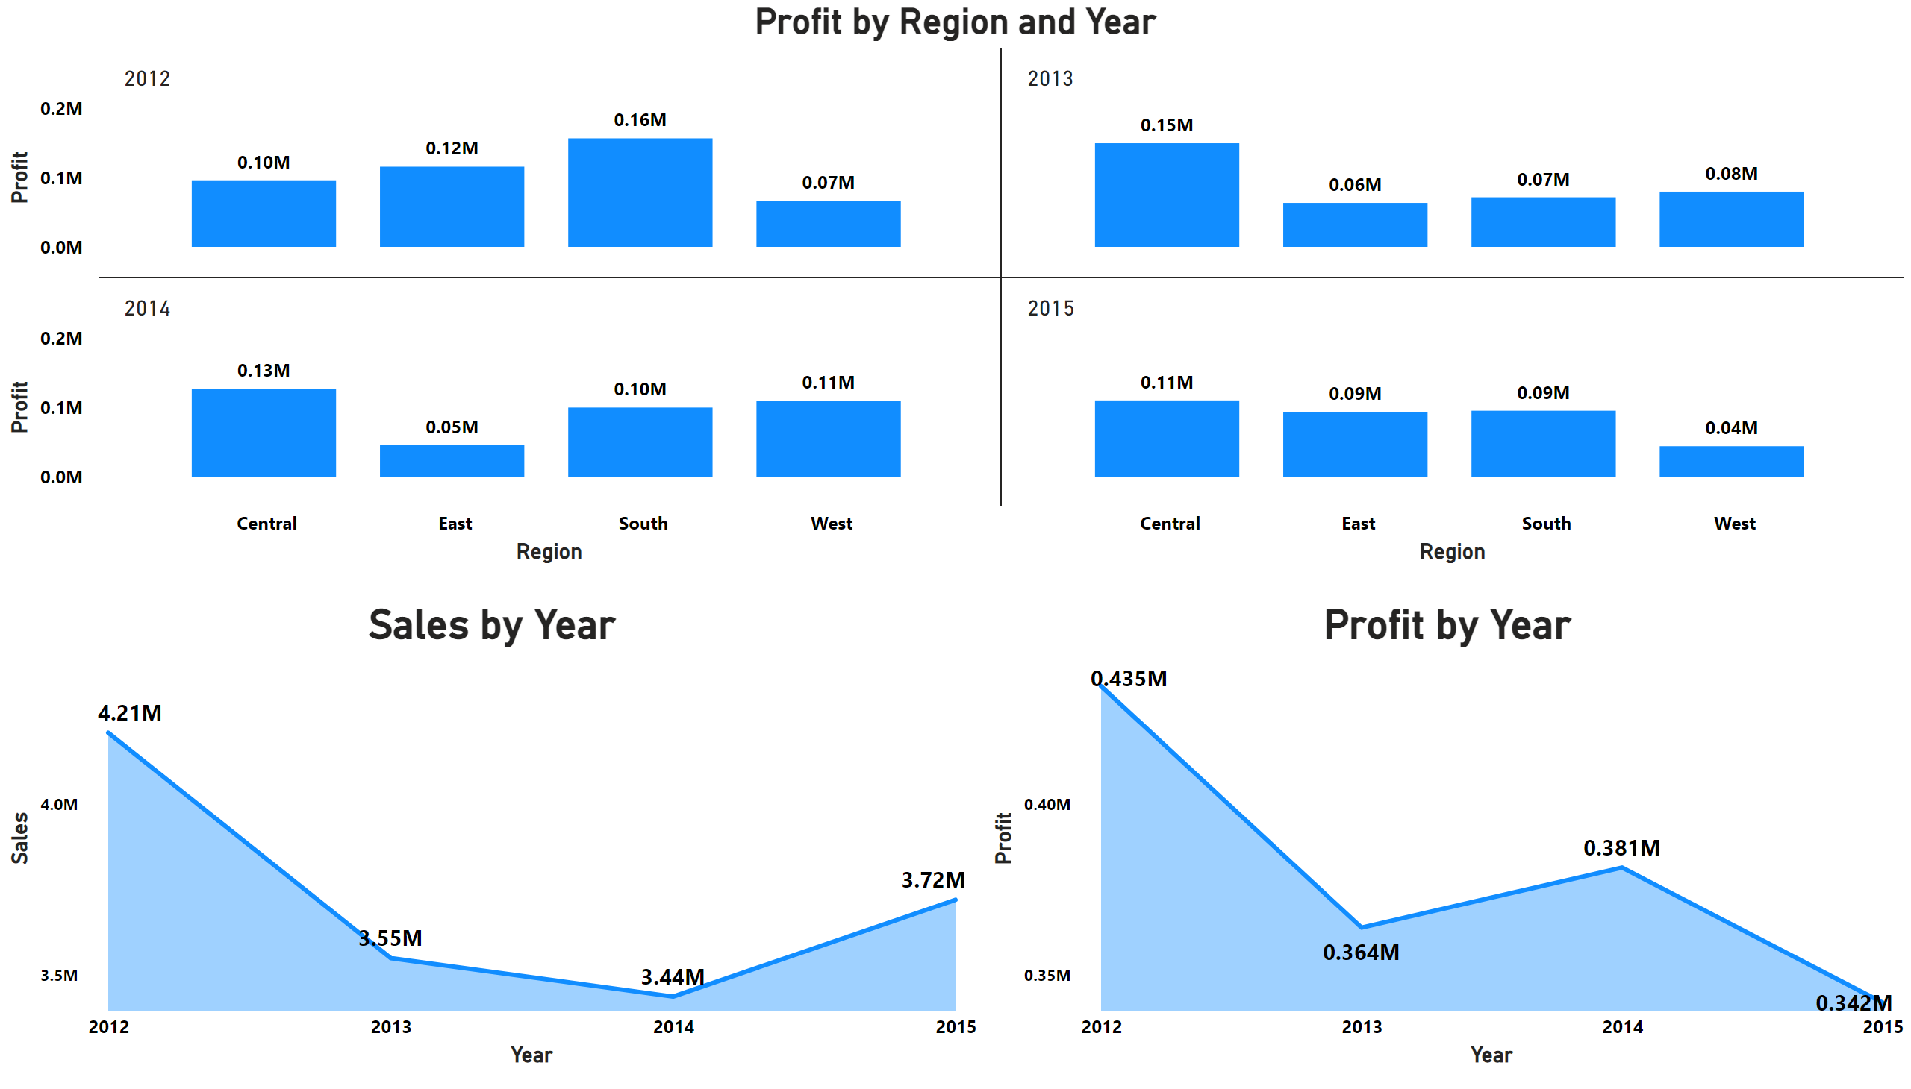
Year and region
Notes:
Sales by Year
No alt text provided
Profit by Year
No alt text provided
Profit by Region and Year
No alt text provided

